Slide 1
Report on information and cummunication (tic) and related technologies
Exoloring innovation and connectivity in TIC

Slide 2
Summary:
Title | Page Numbre
Introduction | 3
Definition of a tic | 4
Google service | 5-7
Microsoft tools | 8-9
Git and github | 10-12
conclusion | 13

Slide 3
introduction
Information and communication technologies (TIC) stand as pivotal elements in our modern era, serving as vital catalysts for enhancing and facilitating various aspects of our daily lives. This report aims to explore and analyze ICT and its interconnected technologies, such as Google services, Microsoft tools, Git, and GitHub.
The focus will be on understanding their effective impact and significance in achieving integration and advancement across multiple domains.
We will examine how their systematic utilization combines content and form to produce a comprehensive and impactful report.

Slide 4
Definition of TIC:
Information and Communication Technologies (ICT) encompass a set of specialized technologies involved in collecting, processing, and transmitting information. These technologies provide clear examples of the transformation brought about by technological advancements. Through the Internet, business software such as Customer Relationship Management (CRM) systems, analytical data techniques, smartphones and their applications, social networks like Facebook and Twitter, information security measures, and cloud computing,
we observe the dynamic interaction between the components of ICT and their impact on the evolution of communication and information management in the modern era.

Slide 5
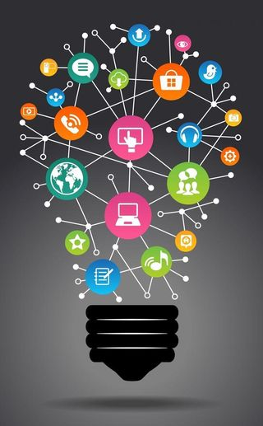
Google service:
Google services refer to a set of online tools and applications provided by Google. These services vary in their functions, including search, email, cloud data storage, productivity tools, and more.
These services are designed to enhance user experience, facilitate communication, and provide access to information in various digital domains.

Slide 6
major sections of Google services:
Search Services: The efficient means to search for information on the internet quickly.
Email and Communication Services: A set of tools and platforms designed to facilitente electronic cummunication and enhance collaboration.
Documents and Productivity Services: Tools and platforms designed to create and edit digital documents, fostering collaboration and productivity.
Maps and Location Services: Providing map and location services for location identification and navigation.
Analytics and Marketing Services : Utilizing data to understand user behavior and enhance marketing strategies.
Cloud and Development Services: Providing online computing resources and tools for developing and managing applications.
AI and Machine Learning Services: Leveraging AI and ML to enhance applications and processes..
Security Services :Securing data and information from potential threats and ensuring overall cybersecurity.

Slide 7
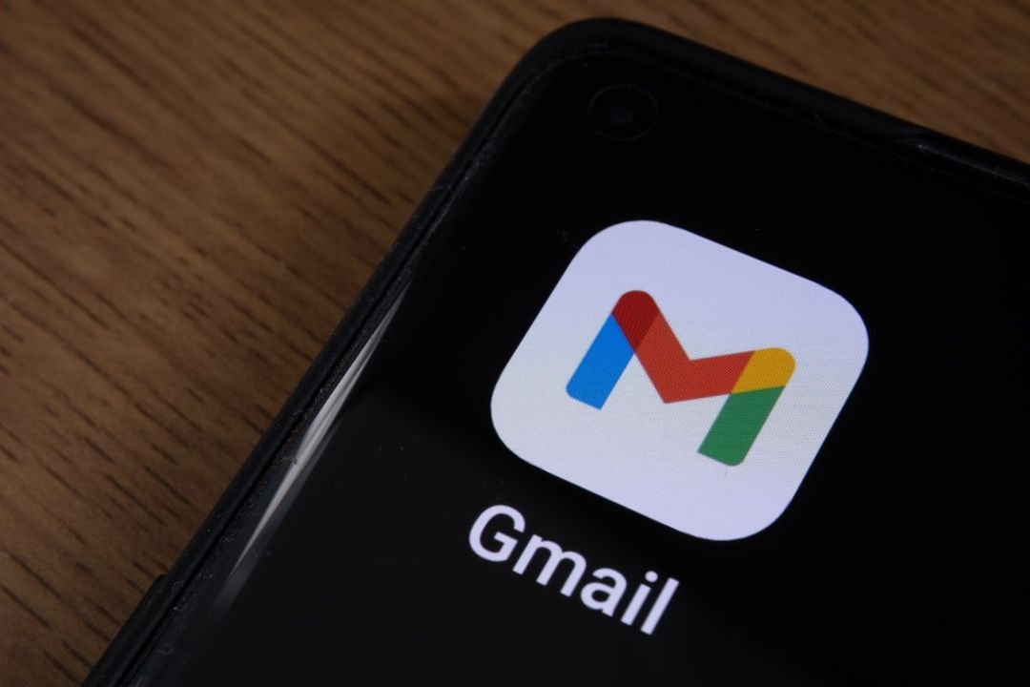



Exemple about google service:
Gmail: Email service, boasting over
A billion users and widespread popularity,
Youtube: Platform for watching and sharing online videos.
Google Maps: offers mapping, navigation, and location services.

Slide 8

Microsoft Tools:
It is a suite of software and services provided by Microsoft to meet various needs in areas such as personal productivity, team collaboration, software development, business management, and cloud computing. It includes popular office applications such as Word, Excel, and PowerPoint.

Slide 9

Microsoft tools AND Integration with tic
tool | description | Integration in tic
Office 365 | A suite of online office applications including Word,excel,powerpoint and more | Facilitates online collaboration and easy file sharing.
Microsoft teams | Video meetings and collaboration platform. | Enhances team communication and collaboration
azure | Cloud computing platform for application development. | Supports web apps and cloud storage.
SharePoint | Content management and collaboration system. | Facilitates file sharing and collaboration
Power Bl | Data analysis tool for creating interactive reports. | Enhances data understanding and decision-making.

Slide 10

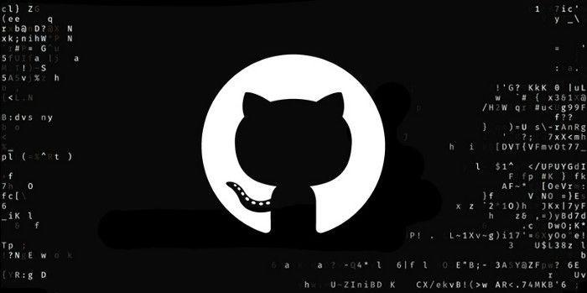
GIT and GitHub:
Git:
is a distributed version control system used to track changes in source code during software development. Developers collaborate efficiently on projects using Git.
GitHub:
is a web-based platform built on Git for version control. It provides a central hub for developers to host, manage, and collaborate on software projects.

Slide 11

The difference between Git and GitHub:
GIT | GITHUB
Is software | Is a service
Installed locally on the systeme | hosted on the web
Focused on version control and code sharing | Focused on centralized source
Maintained by linux | Maintained by microsoft

Slide 12

Integration with information and communication technologies :
Git and GitHub are fundamental in Information and Communication Technologies (TCI), providing a robust version control system and collaboration platform for software development projects. They support distributed teams, ensuring seamless collaboration in code writing and improving the efficiency of development processes., enhancing effective communication and fostering teamwork in software development.

Slide 13
Conclusion:
In conclusion, this report highlights the significance of Information and Communication Technologies (ICT) in our modern world, where Google services, Microsoft tools, Git version control, and GitHub collaboration platform play vital roles in improving communication and increasing productivity in software development realms. Utilizing these technologies enables effective integration across systems and teams, contributing to process improvement and efficient goal attainment. These tools also showcase the power of collaboration and integration to achieve technological advancements and enhance the digital environment for users.

Slide 14
Thank You for Your Interest!
we extend our sincere thanks and gratitude to you for the valuable opportunity you have given us to present this report. It has been a fruitful experience and a chance to broaden our knowledge. Thank you for the suppor you have provided throughout this period.
Prepared by : Group 17

